Slide 1

DAB: 303 Marketing Analytics
Title: Big Mart Sales Analysis
Mentor: Pratik Bedi
Submitted By: Ankitkumar K. Padhiar
ID: 0803142

Slide 2
Introduction
Big Mart promises to provide excellent opportunities for establishing meaningful connections, helping advertisers grow their businesses rapidly.
Despite the competitive market, Big Mart is determined to thrive, inspired by the quote: "Don't limit yourself; you can go as far as your mind lets you."
President - Soon Park expresses the ultimate goal of prospering alongside customers, ensuring a satisfying experience in shopping and marketing at low costs.

Slide 3
About Us
Website: http://bigmart.com
Employees: 79
Address: 230 E Winston St 31, Los Angeles, California 90013, US
Phone: (213) 629-4626
Technologies: GoDaddy DNS, GoDaddy Website Builder, MyOperator
Category: Retail, Automotive
Competitors: Dalzell Jewelers, Joberry, PPE Pros, Shop ModEnvvy
SIC: 533, 53 (Standard Industrial Classification)
NAICS: 45,455,452 (North America Industry Classification System)
https://rocketreach.co/big-mart-profile_b45d20d7fc62eda3

Slide 4

Management
President Soon W Park
Procurement Manager Bhim Sapkota
Finance
Stefano Rasquel
HR Parul Dhakal
Marketing Junior Santos
Sales Ho Trinh
Head of Supply Chain Gopal Thapa
https://rocketreach.co/

Slide 5
Market
Summary

Slide 6

Market Summary
Started small with a single store in April 2007, today Big Mart has become a well-known name in the retail industry with more than 40 outlets in world.
With our unmatched services, attractive prices and high-quality products, we have touched the lives of young customers.
Why Big Mart World?
We Provide: 1. Grocery Products 2. Dairy Products 3. Organic Foods 4. Bakery Foods 5. Frozen Food 6. Free Home Delivery Customer satisfaction and value for the stakeholders are our major goals which we try to fulfill with our four pillars: quality of the products, the speed of service, rewarding experience, and environmental responsibility.
Big Mart announced in October 2007 that the first California and Arizona stores would open November 8. However, on November 1, 2007, Big Mart opened its first store, in Hemet, California, as a "soft opening".
Big Mart World’s Estimated Revenue:
$14 Million/year
https://growjo.com/company/

Slide 7
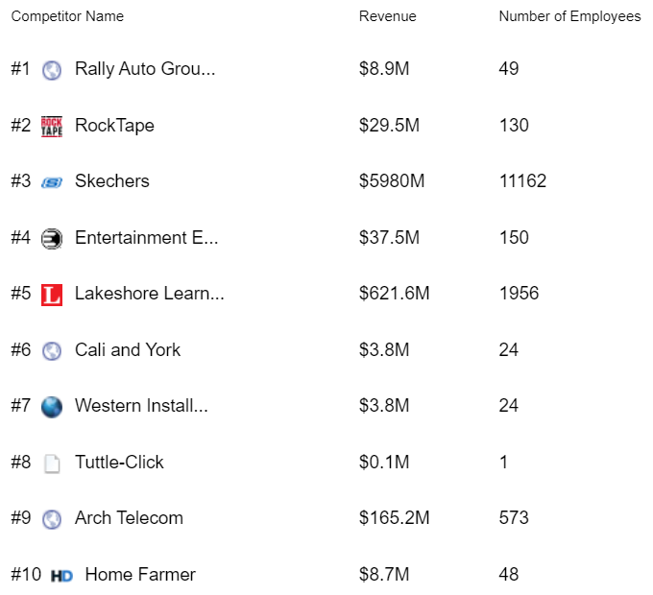

Competitors
https://www.freepik.com/premium-vector/
https://growjo.com/company

Slide 8
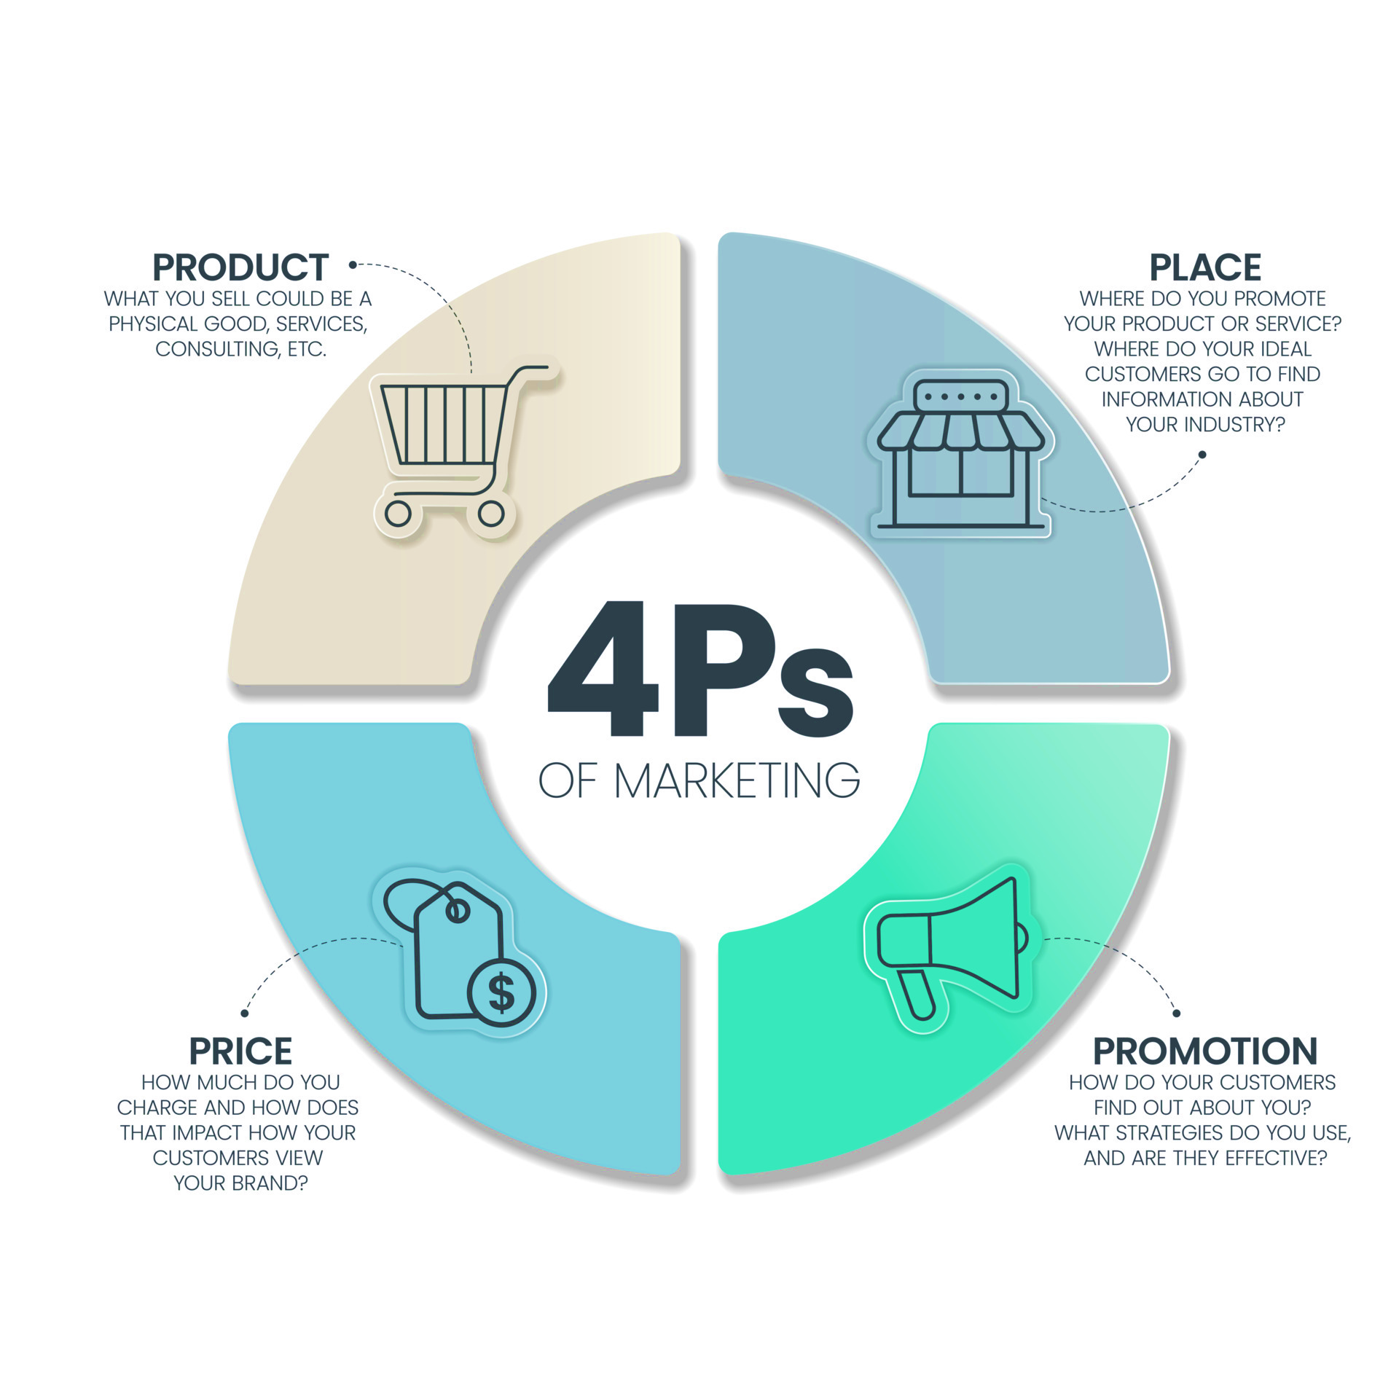
What can we do?
Companies need to market their products and get the most out of them by effectively using four p’s of marketing.
They will help firms to stand tall in the community by considering all the factors.
Also, a better marketing strategy will pay off in the long run by letting to meet our customer via effective market penetration, sustainable market presence, and a loyal customer base.
https://www.vecteezy.com/vector-art/

Slide 9
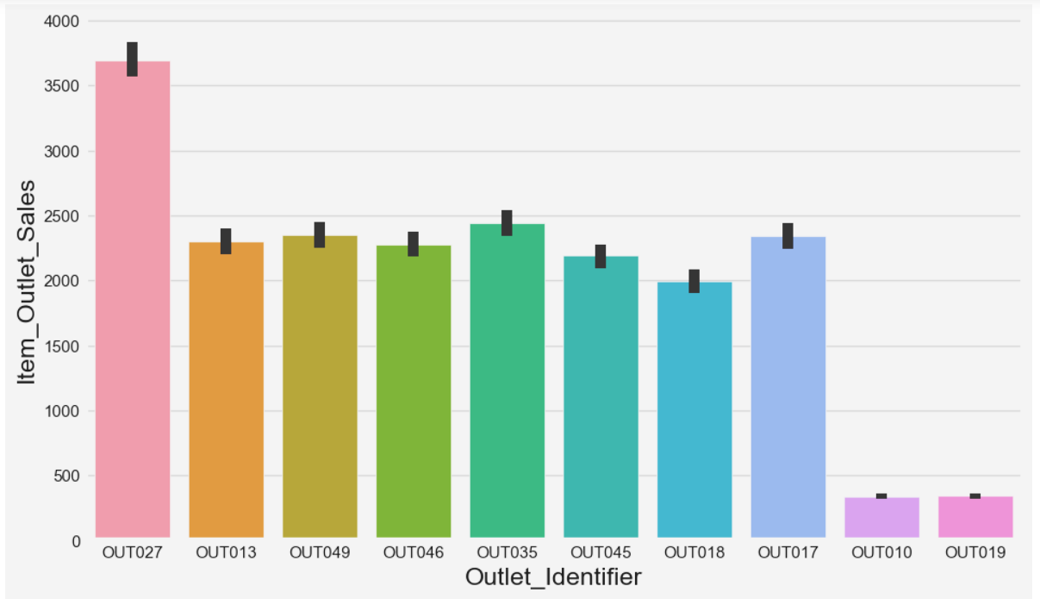
Sales Analysis
From the Bar graph we can say that OUTLET No. 027 has highest sales amount, which could mean that it has a large customer base, a high demand for its products, or a competitive pricing strategy.
On the other side, we need to identify necessary steps to improve the sales on Outlet No. 019 which has least sales.
Outlet Identifier and Sales

Slide 10
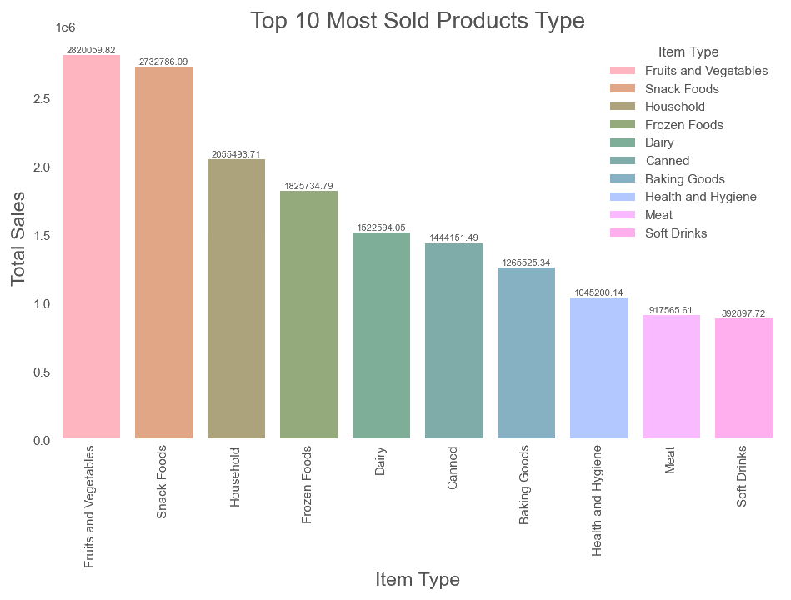
Sales Analysis…
From the Bar graph we can say that most favorite or in demand merchandise type is Fruits and vegetables.
On the other side, we can say that people has less interest in soft drinks.

Slide 11
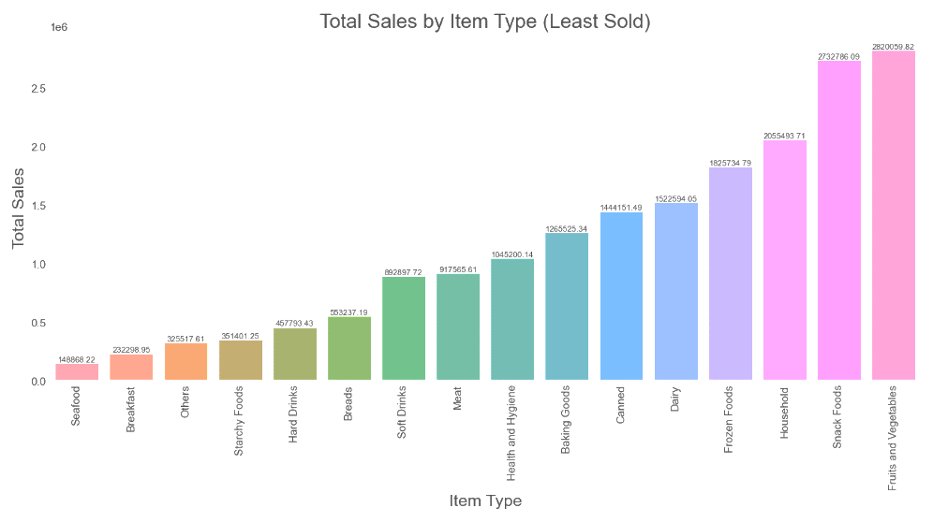
Sales Analysis…
From the Bar graph, we can see that the least Item type being sold in Outlet is Seafood.

Slide 12
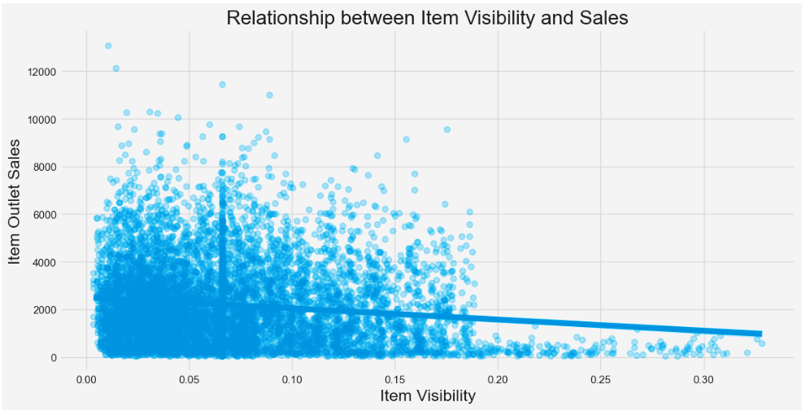
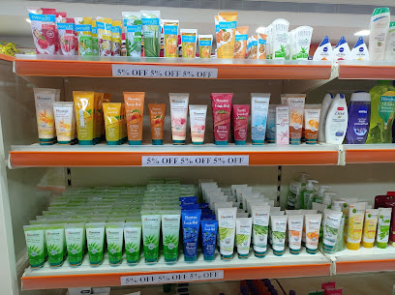
Sales Analysis…
This graph depicts the relationship between Item Visibility and sales depicting that how the visibility affects the overall sales of the items.
The more depth of visibility will affect the sales of Items which results in overall performance of the Outlets Sales.
Visibility is the measure that how easy it is for customers to find and notice the item in store or online. It can be influenced by factors such as shelf placement, packaging, advertising, and word-of-mouth.
https://zaubee.com/biz/

Slide 13
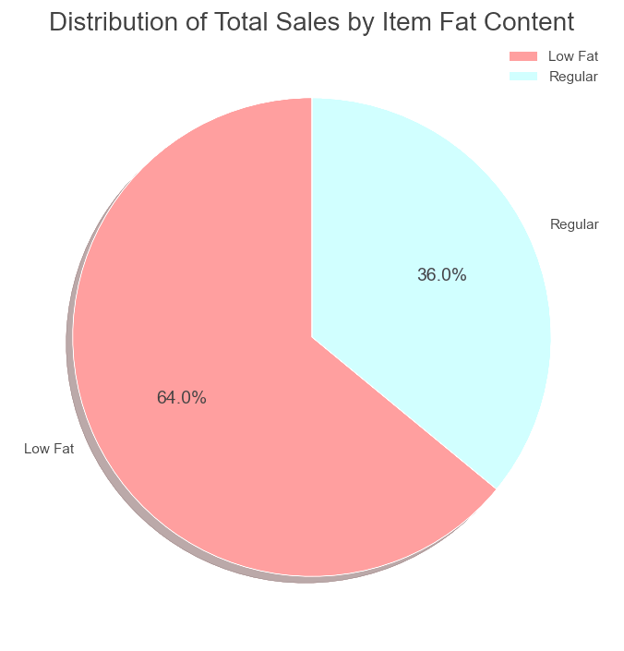
Sales Analysis…
From the Pie chart, we can see that low fat items are selling more than the Regular one.

Slide 14
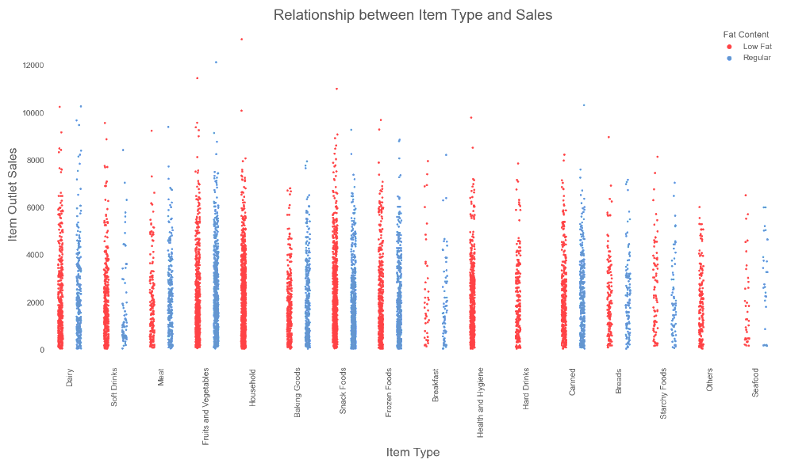
Sales Analysis…
From the Strip plot, we can see the distribution of sales for each Item Type according to the Fat Content.
We can see that Fruits & Vegetables and snacks have equal sales distribution.

Slide 15
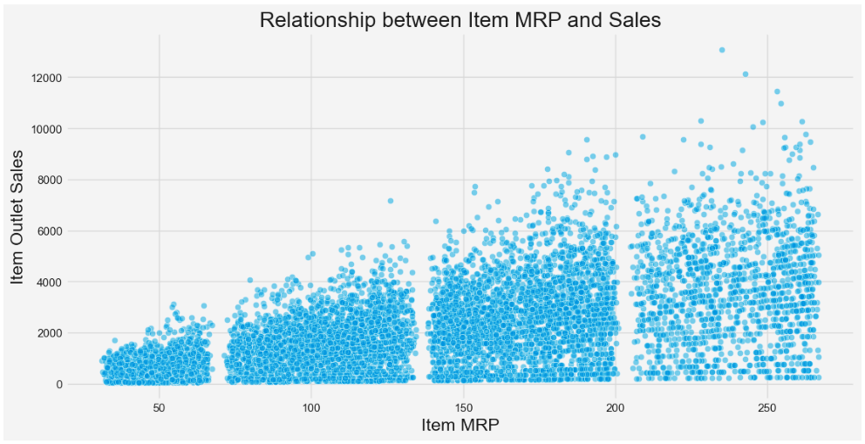
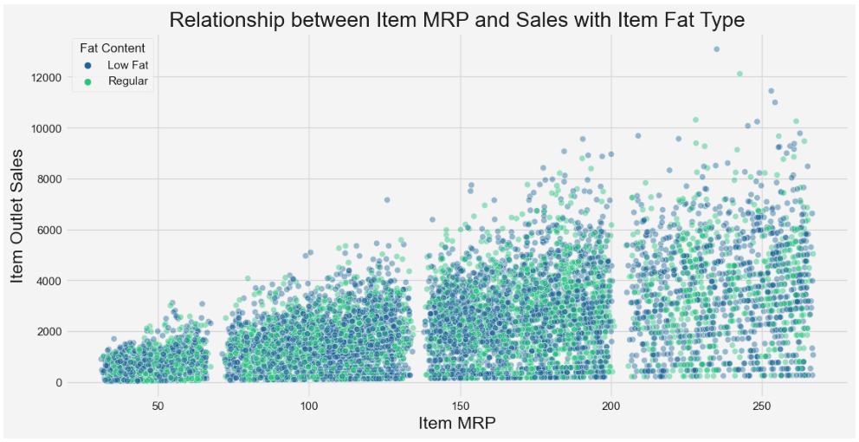
Sales Analysis…
This graph identifies the potential pricing of product that helps to determine our product price.
Item with price between 100-150 have more sales.
This shows that customers prefer to buy the items between price of 50-150.

Slide 16
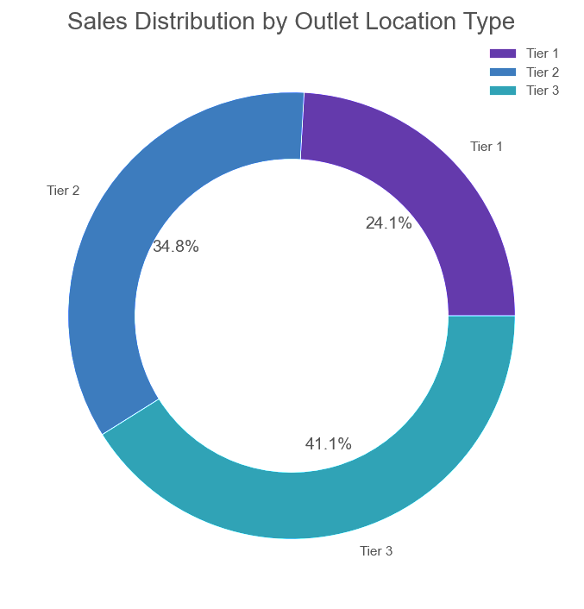
Sales Analysis…
Insights:
Tier 3 Outlets have the highest sales by 41.1% of the total sales. This suggests that these outlets are more profitable than the other two types of locations. Tier 1 outlets have the lowest sales with only 24.1% of the total outlet sales. This implies that these outlets are either less efficient, less attractive, or less accessible than other two type of tiers.
Recommendation:
Identify the factors that make Tier 1 Outlets more successful than other.
These factors may include Place, pricing, promotions and quality service. We can try and implement these affecting factors to improve the sales of the Tier 1 Outlets.

Slide 17
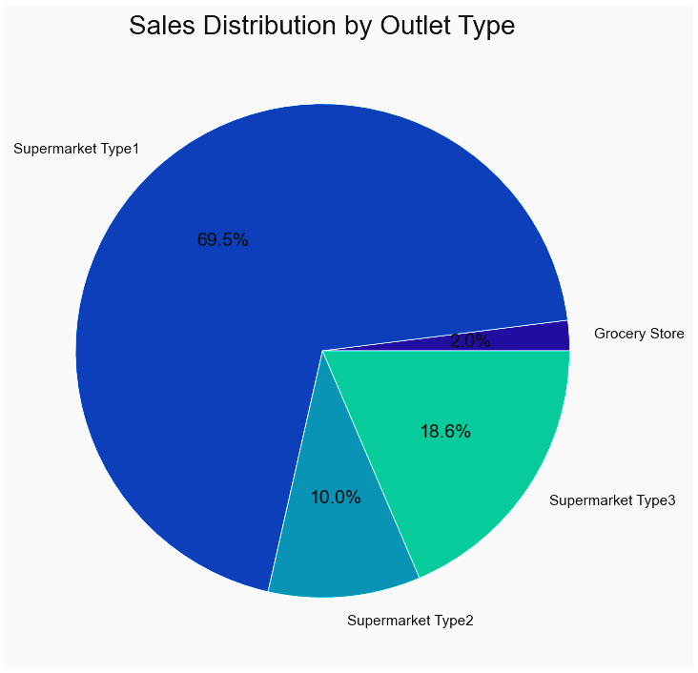
Sales Analysis…
Recommendation:
Provide value to your customers by solving their problems, meeting their needs.
Offer them high-quality products, competitive prices, convenient delivery.
Create value added services or promotional offers that differentiate products from competitors and increase customer relations.
Present the products effectively by highlighting their features, benefits and advantage over other options.
Offer complementary products, discounts, freebies or incentives to encourage customers to buy more and more or upgrade their purchases.
Loyalty programs, referrals or subscriptions to generate repeat lifetime values.
Insights:
We can see that Supermarket Type 1 with 69.5% has more domination than the Grocery Stores with 2.0%.

Slide 18
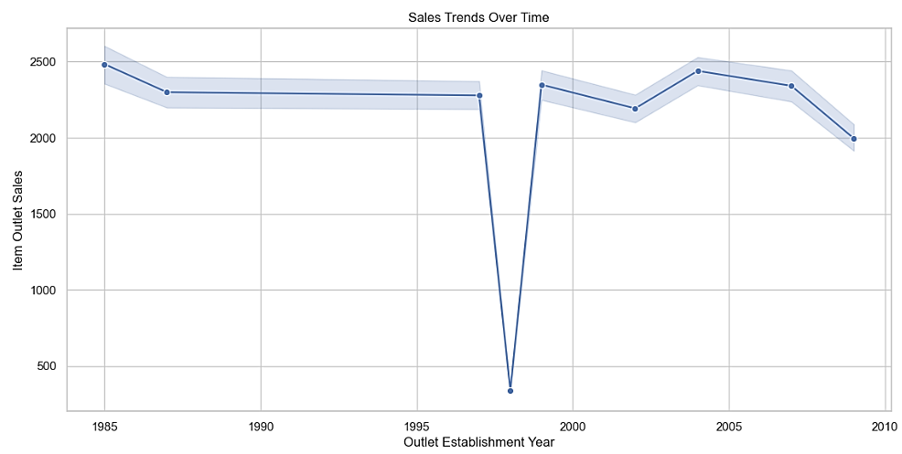
Sales Analysis…
Recommendation:
Need to think of sales analysis for more growth.
Customer acquisition, pricing, location of the store.
What went wrong ?
How can we overcome the low sales ?
Identify the inventory, logistics, suppliers and other operations method.
Insights:
We can clearly see that in early days due to lack of technology and no analysis metrics methodology, the sales were stable till 1997.
In 1998, the sales declined with huge numbers.

Slide 19
SWOT Analysis
Strength
Our strengths are the advantages we have in relation to the market and our competitors. Unique Selling Propositions (USPs) and the areas our brand should focus on to differentiate from others. A strong online presence, diverse service offerings and in-house talent can be served as strengths.
Weakness
Our weaknesses are the characteristics of our company that place us at a disadvantage compared to others. Limited resources, poor differentiation from competitors and negative customer perceptions are weaknesses that affect marketing plan.
Threats
Threats are elements in our business’s environment that hurt our company’s potential to compete in the market. Economic downturns, tighter regulations and increasing competition are all of threats that can impact our marketing efforts.
Opportunity
Opportunities are elements in our business’s environment that have the potential to improve our position. We can work on the emergence of new technology and new consumer behaviors or buying preferences.

Slide 20
“Don't limit yourself; you can go as far as your mind lets you” -Soon W Park

Slide 21
References
https://www.bigmart.com/about-us.html
https://rocketreach.co/big-mart-profile_b45d20d7fc62eda3
https://www.naics.com/what-is-the-difference-between-naics-codes-and-sic-codes/
https://growjo.com/company/Big_Mart_World#what-is
https://the-corporate.com/profile/BigMart-Supermarket-1
https://slidesgo.com/
https://www.kaggle.com/

Slide 22
Thank You.

